Slide 1

Unemployment
0
28
P R I N C I P L E S O F
F O U R T H E D I T I O N
Notes:
This chapter is neither particularly long nor difficult, so most instructors are able to cover it using about 90 minutes of class time. If you’re looking for ways to further shorten your presentation, you can omit some or all of the slides showing labor market statistics for various sub-groups of the population, and simply refer your students to read about them in the chapter. (I encourage you to keep the slide showing unemployment rates by education, though – it is excellent motivation for students to finish their college education!.)
One of the Active Learning activities requires students to calculate labor force statistics based on recent U.S. data. It would be helpful to warn your students in advance to bring a calculator to class on the day you cover this chapter.

Slide 2
In this chapter, look for the answers to these questions:
0
How is unemployment measured?
What is the “natural rate of unemployment”?
Why are there always some people unemployed?
How is unemployment affected by unions and minimum wage laws?
What is the theory of efficiency wages, and how does it help explain unemployment?

Slide 3
Labor Force Statistics
0
Produced by Bureau of Labor Statistics (BLS),
in the U.S. Dept. of Labor
Based on regular survey of 60,000 households
Based on “adult population” (16 yrs or older)
Notes:
Students may recall that the BLS also produces the CPI statistics.

Slide 4
Labor Force Statistics
0
BLS divides population into 3 groups:
  employed: paid employees, self-employed,
  and unpaid workers in a family business
  unemployed: people not working who have looked for work during previous 4 weeks
  not in the labor force: everyone else
The labor force is the total # of workers, including the employed and unemployed.
Notes:
Good idea: Tell students to take good notes on this slide and the following one, because in a moment they will have to use these definitions to solve a problem. You can tell them the problem is very similar to what they might see on their next exam – that always gets their attention!
Basically, someone is considered “employed” if they’re working. Someone is “unemployed” if they aren’t working but want to be.
Someone is “not in the labor force” if they aren’t working and aren’t trying to find a job.

Slide 5
Labor Force Statistics
0
Unemployment rate (“u-rate”):
% of the labor force that is unemployed
u-rate
= 100 x
# of unemployed
labor force
Labor force participation rate:
% of the adult population that is in the labor force
labor force participation rate
= 100 x
labor force
adult population
Notes:
Many of the following slides abbreviate “unemployment rate” as “u-rate” to reduce slide clutter and to reduce the burden on students who are rushing to copy everything on the screen into their notes.

Slide 6
A C T I V E L E A R N I N G 1:
Calculate labor force statistics
0
Compute the labor force, u-rate, adult population, and labor force participation rate using this data:
Adult population of the U.S. by group, January 2006
# of employed | 143.1 million
# of unemployed | 7.0 million
not in labor force | 77.4 million
Notes:
This exercise gives students immediate reinforcement and application of the concepts on the preceding slides. It prepares them for some of the kinds of questions they might see on your exam. And it gives them a sense of the actual magnitude of these statistics in the U.S. in a recent month.
Suggestion: Before lecturing on this chapter, update the numbers in this table (and in the answers that follow) using the latest available data, which you can find here:
Data source: Bureau of Labor Statistics, U.S. Department of Labor
http://www.bls.gov, look for latest “Employment Situation Survey”

Slide 7
A C T I V E L E A R N I N G 1:
Answers
0
Labor force = employed + unemployed
= 143.1 + 7.0
= 150.1 million
U-rate = 100 x (unemployed)/(labor force)
= 100 x 7.0/150.1
= 4.7%
Notes:
Your students may get slightly different answers due to rounding differences.

Slide 8
A C T I V E L E A R N I N G 1:
Answers
0
Population = labor force + not in labor force
= 150.1 + 77.4
= 227.5
LF partic. rate = 100 x (labor force)/(population)
= 100 x 150.1/227.5
= 66.0%
Notes:
Your students may get slightly different answers due to rounding differences.

Slide 9
Labor Market Statistics for Different Groups
0
The BLS publishes these statistics for demographic groups within the population.
These data reveal widely different labor market experiences for different groups.
Notes:
If you need to get through this chapter more quickly, you might consider omitting some of the following slides. However, I recommend that you keep the slide showing unemployment rates by education level – it is excellent motivation for students to finish their college education!

Slide 10
Labor Market Statistics for Whites & Blacks,
January 2006
0
Adults (20 yrs & older)
 | u-rate | LF part. rate
White, male | 3.6% | 76.4%
White, female | 3.7 | 59.7
Black, male | 7.5 | 69.8
Black, female | 8.1 | 64.4
Notes:
Within either racial group, males have higher participation rates than females, but similar unemployment rates.
Blacks and whites have similar participation rates, but blacks have far higher unemployment rates than whites. This is of great concern to many economists and policymakers.
Source: Bureau of Labor Statistics, U.S. Department of Labor
www.bls.gov, look for latest “employment situation”

Slide 11
Labor Market Statistics for Whites & Blacks,
January 2006
0
Teens (16-19 yrs)
 | u-rate | LF part. rate
White | 13.3 | 47.1
Black | 31.4 | 30.9
Notes:
As one would expect, teens have lower participation rates and higher unemployment rates than adults. What is striking, though, are the racial disparities: nearly half of white teens are in the labor force, getting skills and experience that will help them later as adult job market participants. Only about a third of black teens are in the labor force. And the unemployment rate among black teens is nearly three times as high as among white teens.
Source: Bureau of Labor Statistics, U.S. Department of Labor
www.bls.gov, look for latest “employment situation”

Slide 12
Labor Market Statistics for Other Groups,
January 2006
0
All ages
 | u-rate | LF part. rate
Asian | 3.2 | 65.7
Hispanic | 5.8 | 69.3
Notes:
Compared to the national average, unemployment is higher for Hispanics and lower for Asians. The participation rates of these groups are similar to the national average.
Note: Asian is the only demographic group for which seasonally adjusted data were not available. The figures for all other groups are seasonally adjusted. (The seasonal adjustments seem to make relatively little difference in most months.)
Source: Bureau of Labor Statistics, U.S. Department of Labor
www.bls.gov, look for latest “employment situation”

Slide 13
Labor Market Statistics by Education Level,
January 2006
0
Adults (25 yrs & older)
 | u-rate | LF part. rate
less than h.s. | 7.0% | 46.0%
h.s. diploma | 4.4 | 62.5
some college or assoc degree | 3.5 | 72.5
bachelor’s degree or more | 2.1 | 78.3
Notes:
These statistics, not in the textbook, are particularly interesting to college students.
It shouldn’t be surprising that educational attainment is positively related to labor force participation: for most people, the prospect of better jobs is a key reason for investing in education.
Your students may be especially happy to learn that, by getting a bachelor’s degree, they reduce their chances of becoming unemployed by more than half, compared to people with a high school diploma, and by almost half compared to people who don’t finish college.
Source: Bureau of Labor Statistics, U.S. Department of Labor
www.bls.gov, look for latest “employment situation”

Slide 14
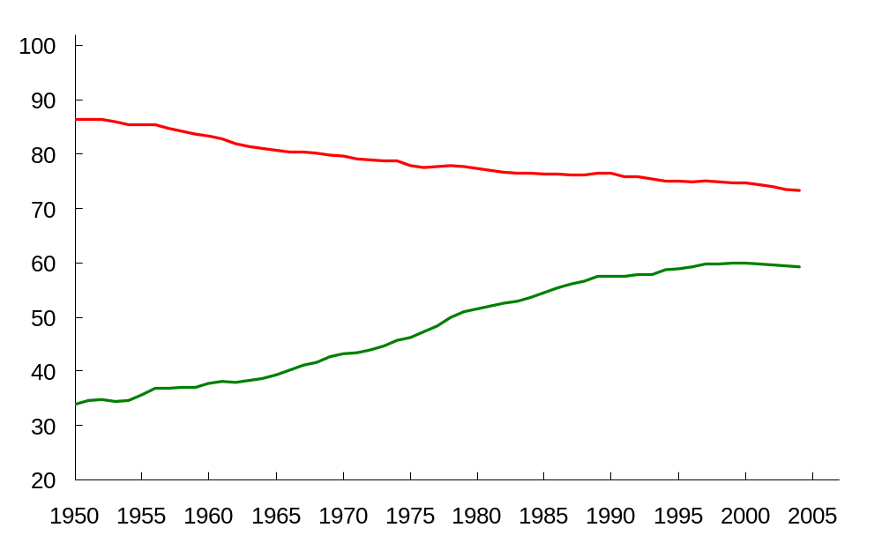
LF Participation Rates by Sex, Since 1950
0
Men
Women
Notes:
This chapter of the textbook contains a new “In the News” with a recent New York Times article by economist Alan Krueger on the rise of the male non-worker.
The male LF participation rate is males in the labor force as a percentage of all males. Similarly for females.
I started the vertical axis at 20 rather than 0 to make the trends more apparent.
Since 1950, female participation has nearly doubled – from 34% to 60%. Male participation has declined from 86% to 73%.
If you can spare a few minutes for class discussion, ask your students two questions:
1) What factors do you think have caused these trends? The textbook offers some explanations; see the Case Study entitled “Labor Force Participation of Men and Women in the U.S. Economy.”
2) What are some of the effects or consequences of these trends?
Source: Same data used to construct Figure 28-3 in the textbook, from Bureau of Labor Statistics, U.S. Department of Labor. New data can be found at www.bls.gov as they become available. Look for the latest “employment situation survey.”

Slide 15
A C T I V E L E A R N I N G 2:
Exercise
0
In each of the following, what happens to the u-rate? Does the u-rate give an accurate impression of what’s happening in the labor market?
A. Sue lost her job, and begins looking for a new one.
B. Jon, a steelworker who has been out of work since his mill closed last year, becomes discouraged and gives up looking for work.
C. Sam, the sole earner in his family of 5, just lost his $80,000 job as a research scientist. Immediately, he takes a part-time job at McDonald’s until he can find another job in his field.
Notes:
The objective of this exercise is to lead students to discover why the unemployment rate is not a perfect indicator of joblessness.

Slide 16
A C T I V E L E A R N I N G 2:
Answers
0
A. Sue lost her job, and begins looking for a new one.
u-rate rises
A rising u-rate gives the impression that the labor market is worsening, and it is.

Slide 17
A C T I V E L E A R N I N G 2:
Answers
0
B. Jon has been out of work since last year,
becomes discouraged, stops looking for work.
Discouraged workers
  would like to work but have given up looking for jobs
  classified as “not in the labor force” rather than “unemployed”
u-rate falls, because Jon is no longer counted as unemployed.
A falling u-rate gives the impression that the labor market is improving, but it is not.

Slide 18
A C T I V E L E A R N I N G 2:
Answers
0
C. Sam lost his $80,000 job, and takes a part-time job at McDonald’s until he finds a better one.
u-rate unchanged, because a person is “employed” whether they work full or part time.
Things are worse, but the u-rate fails to show it.

Slide 19
What Does the U-Rate Really Measure?
0
The u-rate is not a perfect indicator of joblessness or the health of the labor market:
  excludes discouraged workers
  does not distinguish between full-time and
  part-time work, or people working part time because full-time jobs are not available.
  Also, some people may misreport their work status in the BLS survey.
Despite these issues, the u-rate is still a very useful barometer of the labor market & economy.
Notes:
If you choose to skip the preceding exercise, you’ll need to give students a definition of the term “discouraged worker.”
This slide recaps the lessons from the preceding exercise, and mentions an additional point from the text: people may misreport their labor market status to the BLS, perhaps because they think it will help them get public assistance. This also makes the unemployment rate a bit less accurate.
You might remind students that, in earlier chapters, we learned that other macroeconomic indicators were imperfect: GDP is an imperfect indicator of society’s well-being, and the CPI tends to overstate increases in the cost of living. Yet, the unemployment rate remains highly useful. For example, when the unemployment rate rises, it is almost always true that things are getting worse in the labor market.
The BLS computes other measures of joblessness, such as (unemployed plus discouraged workers) as a percentage of (the labor force plus discouraged workers). Refer your students to Table 2 for more details.

Slide 20
The Duration of Unemployment
0
Most spells of unemployment are short:
  Typically 1/3 of the unemployed
  have been unemployed < 5 weeks,
  2/3 have been unemployed < 14 weeks.
  Only 20% have been unemployed > 6 months.
Yet, most observed unemployment is long term.
  The small group of long-term unemployed persons has fairly little turnover, so it accounts for most of the unemployment observed over time.
Knowing these facts helps policymakers design better policies to help the unemployed.
Notes:
The data under the first bullet point come from the BLS (www.bls.gov), the employment situation survey.
Some students think the two facts on this slide contradict each other. The book gives a simple example that helps students understand how these facts can both be true.
These facts imply that economists and policymakers must be careful when interpreting data on unemployment and designing policies to help the unemployed.

Slide 21
Cyclical Unemployment vs. the Natural Rate
0
There’s always some unemployment, though the u-rate fluctuates from year to year.
The natural rate of unemployment
  the normal rate of unemployment around which the actual unemployment rate fluctuates
cyclical unemployment
  the deviation of unemployment from its
  natural rate
  associated with business cycles, which we’ll study in later chapters
Notes:
Unemployment is a serious and complicated problem with a variety of causes. To most effectively address such a problem, we need to break it down and look at each cause separately.
We begin by noting that the causes of short-run fluctuations in unemployment are different than the causes of the long-run average unemployment rate, called the “natural rate of unemployment.”
The next slide shows data on both, for the U.S. economy, for the period 1960-2004.

Slide 22
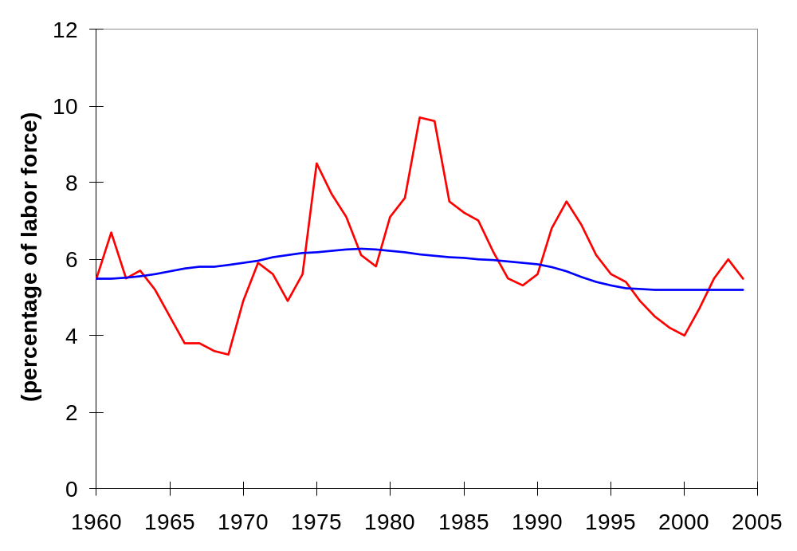
U.S. Unemployment Since 1960
0
Unemployment rate
Natural rate of unemployment
Notes:
Cyclical unemployment is the gap between the red and blue lines. When the economy is in recession – the bad part of the business cycle - the actual unemployment rate is higher than the natural rate, and cyclical unemployment is positive. When the economy is in the good part of its business cycle, unemployment is below normal and cyclical unemployment is negative.
Source: same as textbook.
The unemployment rate comes from the Department of Labor and is available at www.bls.gov.
The natural rate of unemployment series is prepared by the Congressional Budget Office. I have not been able to find it at the CBO website (www.cbo.gov). It is available (with tons of other data) at www.economagic.com; paid subscribers can download it in Excel format; others can view it at their site for free.
If you find a free source for the CBO’s natural rate series, please let me know! Thanks.

Slide 23
Explaining the Natural Rate: An Overview
0
Even when the economy is doing well, there is always some unemployment, including:
frictional unemployment
  occurs when workers spend time searching for the jobs that best suit their skills and tastes
  short-term for most workers
structural unemployment
  occurs when there are fewer jobs than workers
  usually longer-term
Notes:
In later chapters, we will study short-run economic fluctuations and learn more about the causes and possible cures of cyclical unemployment. For the rest of this chapter, our job is understanding the various causes of the natural rate of unemployment.
* * WARNING: If you are teaching with Mankiw for the first time, please note that his definition of structural unemployment may be different than the definition you’ve seen in other textbooks.
Other books commonly define structural unemployment as arising from a mismatch between the skills or locations of workers and the skill requirements or locations of jobs. Such textbooks assert that such unemployment results from sectoral shifts.
Mankiw’s position is as follows: If all wages were flexible, then they would adjust after structural changes so that all workers with any given skill set in any given location would be employed. The cause of “structural unemployment” therefore cannot be changes in the structure of demand and production; the cause must be wages that fail to adjust following these changes.

Slide 24
Job Search
0
Workers have different tastes & skills, and
jobs have different requirements.
Job search is the process of matching workers
with appropriate jobs.
Sectoral shifts are changes in the composition of demand across industries or regions of the country.
Such shifts displace some workers,
who must search for new jobs appropriate
for their skills & tastes.
The economy is always changing,
so some frictional unemployment is inevitable.

Slide 25
Public Policy and Job Search
0
Govt employment agencies:
give out information about job vacancies to speed up the matching of workers with jobs
Public training programs:
aim to equip workers displaced from declining industries with the skills needed in growing industries

Slide 26
Unemployment Insurance
0
Unemployment insurance (UI):
a govt program that partially protects workers’ incomes when they become unemployed
UI increases frictional unemployment.
To see why, recall one of the
Ten Principles of Economics:
People respond to incentives.
UI benefits end when a worker takes a job,
so workers have less incentive to search or
take jobs while eligible to receive benefits.
Notes:
New to the 4th edition is an “In the News” box with a 2003 WSJ article on high unemployment and welfare reform in Germany. Encourage your students to read it.

Slide 27
Unemployment Insurance
0
Benefits of UI:
reduces uncertainty over incomes
gives the unemployed more time to search, resulting in better job matches and thus higher productivity

Slide 28
Explaining Structural Unemployment
0
Structural unemployment
occurs when not enough jobs to
go around.
unemp-loyment
W
S
actual wage
W₁
W_{E}
Occurs when wage
is kept above eq’m.
There are three reasons for this…
D
L
Notes:
On this graph, W_{E} is the equilibrium wage.

Slide 29
1. Minimum-Wage Laws
0
The min. wage may exceed the eq’m wage
for the least skilled or experienced workers, causing structural unemployment.
But this group is a small part of the labor force, so the min. wage can’t explain most unemployment.
Notes:
As in previous chapters, “eq’m” is short for “equilibrium.”
The 4th edition of the textbook has a new FYI box entitled “Who earns the minimum wage?” It summarizes a 2005 study by the Department of Labor detailing minimum wage earners.

Slide 30
2. Unions
0
Union: a worker association that bargains with employers over wages, benefits, and working conditions
Unions exert their market power to negotiate higher wages for workers.
The typical union worker earns 20% higher wages and gets more benefits than a nonunion worker for the same type of work.
Notes:
Information about the union wage premium differs. The textbook says that union wages are 10-20% higher. Other sources, such as the AFL-CIO and the New York Times article featured in the “In the News Box,” say the figure is closer to 20%, not including the increased benefits that union workers enjoy. The BLS (stats.bls.gov) reports that, in 2004, median weekly earnings of full-time employed workers were $781 for union members and $612 for non-union members – a difference of 28%.
So the range of estimates seems to be about 10-30%. I picked 20%, a nice round number in the middle of this range, to put on this slide in the 3rd bullet point.
In preparing these PowerPoints, I had to make judgments about which details from the textbook to omit (it would be neither possible nor desirable to include every detail from the book in these PowerPoints). I have omitted the terms “collective bargaining” and “strike,” along with their definitions. I was reluctant to do so, as they are boldfaced terms with definitions in the margins. However, most students know these terms already (as well as the definition of “union”), and they aren’t necessary for the presentation of material in this section. I respect that you might disagree with me, though, and encourage you to add these terms & their definitions to your presentation if you feel it appropriate.

Slide 31
2. Unions
0
When unions raise the wage above eq’m,
quantity of labor demanded falls and unemployment results.
“Insiders” – workers who remain employed,
they are better off
“Outsiders” – workers who lose their jobs,
they are worse off
Some outsiders go to non-unionized labor markets, which increases labor supply and reduces wages in those markets.

Slide 32
2. Unions
0
Are unions good or bad? Economists disagree.
Critics:
Unions are cartels. They raise wages above eq’m, which causes unemployment and/or depresses wages in non-union labor markets.
Advocates:
Unions counter the market power of large firms, make firms more responsive to workers’ concerns.
Notes:
Before leaving this section, you should encourage your students to read the “In the News” box entitled “Should you join a union?”. It’s a bit older – from 1997 – but it very nicely outlines the advantages that union members enjoy, as well as other effects unions have in the economy.

Slide 33
3. Efficiency Wages
0
The theory of efficiency wages:
firms voluntarily pay above-equilibrium wages to boost worker productivity.
Different versions of efficiency wage theory suggest different reasons why firms pay high wages.
Notes:
In the case of unions and minimum wage laws, firms that pay above-equilibrium wages do so involuntarily. The theory of efficiency wages, however, suggests that firms may willingly pay extra-high wages in order to increase the productivity of their workers.

Slide 34
3. Efficiency Wages
0
Four reasons why firms might pay efficiency wages:
1. Worker health
In less developed countries, poor nutrition is a common problem. Paying higher wages allows workers to eat better, makes them healthier, more productive.
2. Worker turnover
Hiring & training new workers is costly.
Paying high wages gives workers more incentive to stay, reduces turnover.
Notes:
1. This is clearly not relevant in rich countries like the U.S., where equilibrium wages for nearly all workers are way more than enough to provide for the workers’ nutritional requirements. But rich countries have a fairly small proportion of the world’s population.
2. Besides the costs of placing ads, interviewing candidates, and training new hires, new workers are usually less productive in their first few months on the job – it takes time to learn how to perform their duties efficiently. For all of these reasons, turnover is costly to firms.

Slide 35
3. Efficiency Wages
0
Four reasons why firms might pay efficiency wages:
3. Worker quality
Offering higher wages attracts better job applicants, increases quality of the firm’s workforce.
4. Worker effort
Workers can work hard or shirk. Shirkers are fired
if caught. Is being fired a good deterrent?
Depends on how hard it is to find another job.
If market wage is above eq’m wage, there aren’t enough jobs to go around, so workers have more incentive to work not shirk.
Notes:
3. If firms responded to the surplus of labor by reducing wages, then the most competent applicants may choose not to apply, as they may have better opportunities elsewhere.
4. In case you’re not familiar with efficiency wage theory, here’s the Cliff Notes version.
In many jobs, each worker can choose how hard he or she works. For simplicity, suppose there are just two choices: working hard, or “shirking” – neglecting one’s duties and responsibilities at work.
Clearly, the firm suffers when its workers shirk: output and hence revenue & profit are lower. So, the firm fires workers caught shirking. However, monitoring worker effort is costly and imperfect, and workers know there’s a good chance they won’t be caught if they shirk.
Paying workers an above-equilibrium wage gives them an incentive to work hard rather than shirk. If their firm is the only firm paying efficiency wages, then they stand to lose a particularly good job if caught shirking. If all firms are paying efficiency wages, then there will be structural unemployment due to the market wage being above its equilibrium level. In this case, the incentive to work rather than shirk is the prospect of an extended spell of unemployment. This is why Shapiro & Stiglitz titled their 1984 AER article “Equilibrium Unemployment as a Worker Discipline Device.”

Slide 36
A C T I V E L E A R N I N G 3:
Exercise
0
Which of the following would be most likely to reduce frictional unemployment?
A. The govt eliminates the minimum wage.
B. The govt increases unemployment insurance benefits.
C. A new law bans labor unions.
D. More workers post their resumes at Monster.com, and more employers use Monster.com to find suitable workers to hire.
E. Sectoral shifts become more frequent.
Notes:
This would be a good exam question. Answering it correctly requires the following knowledge and skills:
* knowing the definitions of “frictional unemployment” and “sectoral shifts”
* knowing that minimum wage laws and labor unions affect structural, not frictional unemployment
* knowing that unemployment insurance increases frictional unemployment
* being able to match policies and events to the various causes of unemployment discussed in the preceding slides and in the textbook

Slide 37
A C T I V E L E A R N I N G 3:
Answers
0
Which of the following would be most likely to reduce frictional unemployment?
A. The govt eliminates the minimum wage.
C. A new law bans labor unions.
These are likely to reduce
structural unemployment,
not frictional unemployment.
Notes:
The minimum wage and labor unions are two reasons why the actual wage might be above the equilibrium wage, which causes structural unemployment (as Mankiw defines it), not frictional unemployment.

Slide 38
A C T I V E L E A R N I N G 3:
Answers
0
Which of the following would be most likely to reduce frictional unemployment?
B. The govt increases unemployment insurance benefits.
E. Sectoral shifts become more frequent.
These are likely to increase
frictional unemployment, not reduce it.
Notes:
Unemployment insurance increases frictional unemployment by reducing the opportunity cost of being unemployed, and reducing the urgency of finding work.
Because workers have different skills and jobs have different skill requirements, it takes time for workers displaced from declining industries to get jobs in the younger, growing industries. While they are searching, these workers are frictionally unemployed. If sectoral shifts become more frequent, then we would see more of this type of unemployment.

Slide 39
A C T I V E L E A R N I N G 3:
Answers
0
Which of the following would be most likely to reduce frictional unemployment?
D. More workers post their resumes at Monster.com, and more employers use Monster.com to find suitable workers to hire.
Likely to speed up the process of matching workers & jobs, which would
reduce frictional unemployment.

Slide 40
Explaining the Natural Rate of Unemployment: A Summary
0
The natural rate of unemployment consists of
frictional unemployment
  it takes time to search for the right jobs
  occurs even if there are enough jobs to go around
structural unemployment
  when wage is above eq’m, not enough jobs
  due to min. wages, labor unions, efficiency wages
In later chapters, we will learn about cyclical unemployment, the short-term fluctuations in unemployment associated with business cycles.
Notes:
The last sentence is just a reminder to students that there is more to unemployment than what we have covered in this chapter. Our goal here has been to learn about the natural rate of unemployment, the “normal” or average unemployment rate over the long run. We’ll study short-run fluctuations later.

Slide 41
CHAPTER SUMMARY
0
The unemployment rate is the percentage of those who would like to work who do not have jobs.
Unemployment and labor force participation vary widely across demographic groups.
The natural rate of unemployment is the normal rate of unemployment around which the actual rate fluctuates. Cyclical unemployment is the deviation of unemployment from its natural rate, and is connected to short-term economic fluctuations.

Slide 42
CHAPTER SUMMARY
0
The natural rate includes frictional unemployment and structural unemployment.
Frictional unemployment occurs when workers take time to search for the right jobs.
Structural unemployment occurs when above- equilibrium wages result in a surplus of labor.
Three reasons for above-equilibrium wages include minimum wage laws, unions, and efficiency wages.

